Slide 1
FACULTY PERFORMANCE INFORMATION (MIS)
E025: DHWANI SHAH
E030: NISHEE SHELAT
E041: YASHESH SORATHIA

Slide 2
INTRODUCTION
The faculty performance information portal would need a database to store the necessary data about a particular faculty and their accomplishments. The database used in this project consists of multiple tables of professional and personal parameters that help us understand and view the performance of a faculty in the way we desire to. The major professional table consists of books, articles, conferences, papers, patents, projects, etc. whereas the personal table include faculty’s name, age, experience of years, address, email and contact information.
A system like this requires an impressive User-Interface that catches the eye of the viewer and also be appropriate and user-oriented so as to be used on a daily basis

Slide 3
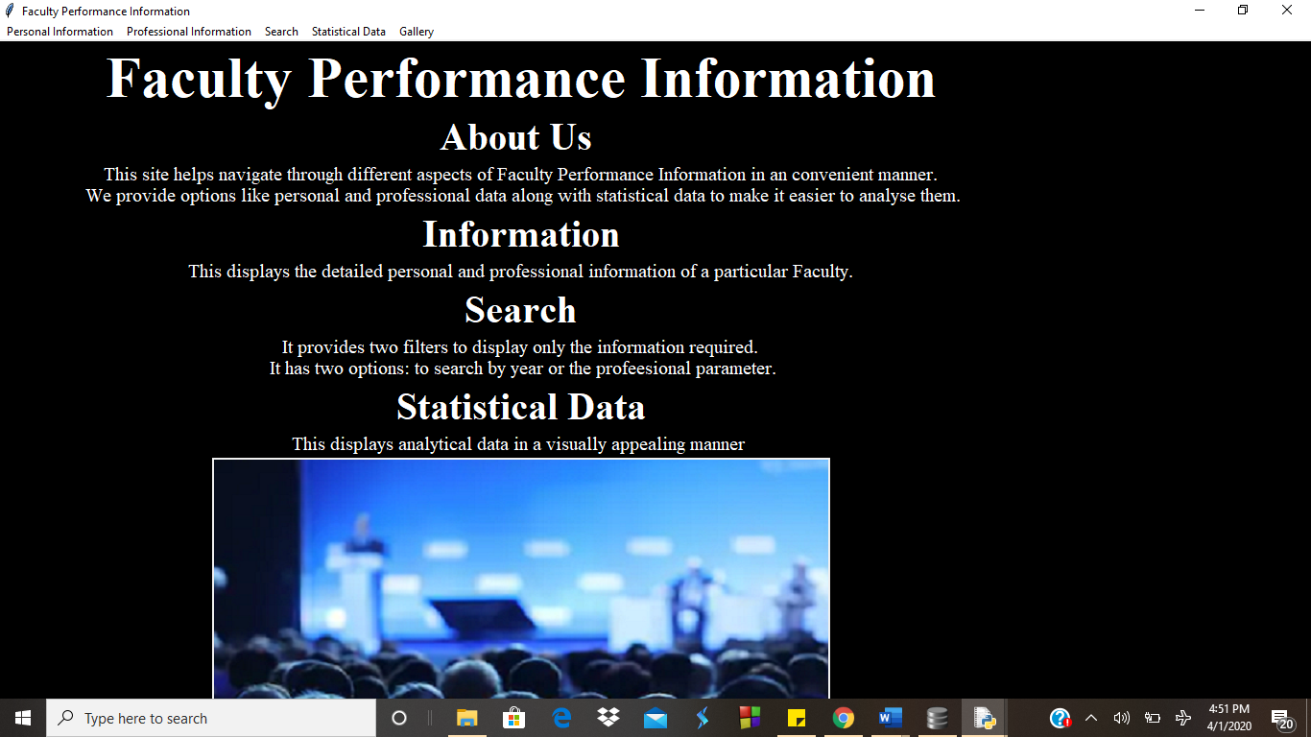
LAYOUT
Front Page

Slide 4
TECHNICAL CONTENT
For the front-end part, Python code was written in IDLE 3.7 32-bit. We have imported python libraries like Tkinter (for GUI), sqlite3 (for database), PIL (for displaying images), matplotlib (for pie charts). The following libraries were used to make the foundation of our project as well as to make it visually appealing.
For the back-end database, we have used DB Brower to store our details about Faculty ( personal/professional ) in tables. These tables are then accessed by the help of sqlite3 library in Python to run queries.

Slide 5
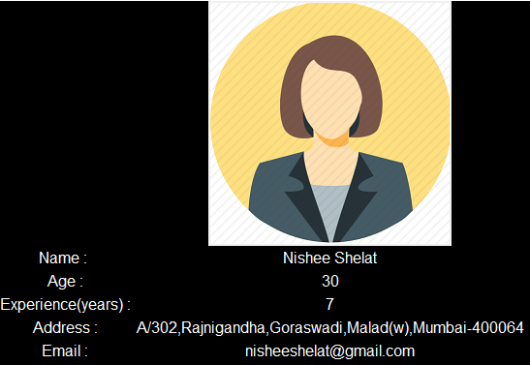
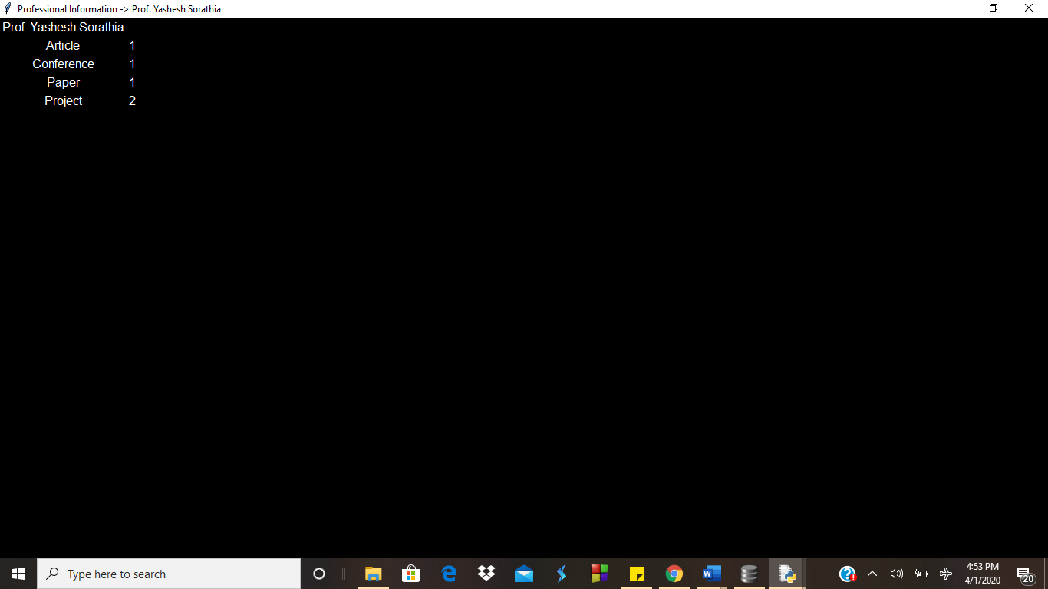
LINKING AND IMPLEMNETATION WITH DEMO
Personal Information
Professional Information

Slide 6
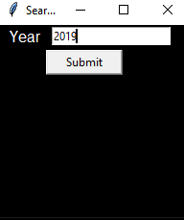
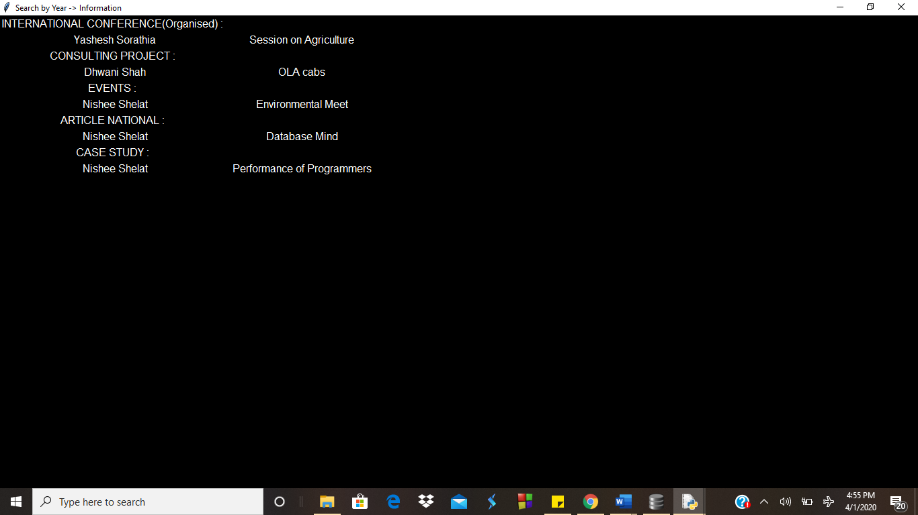
LINKING AND IMPLEMNETATION WITH DEMO
Search by Year

Slide 7
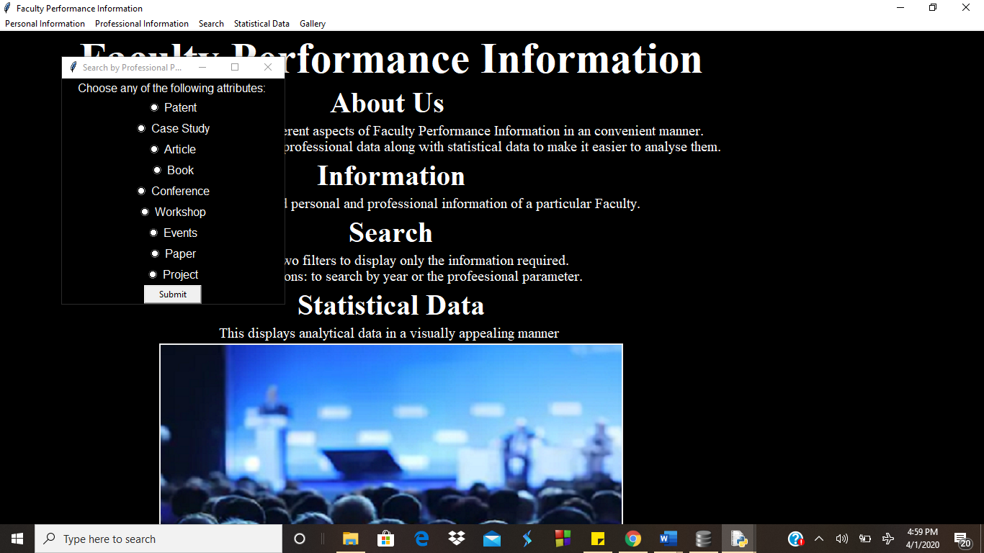
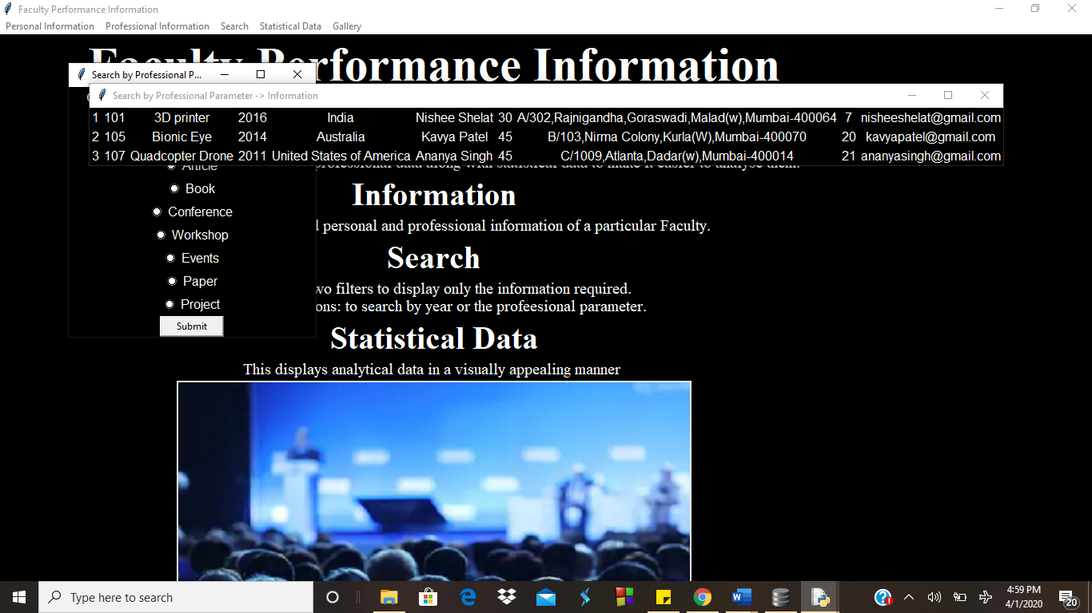
LINKING AND IMPLEMNETATION WITH DEMO
Search by Professional Parameter

Slide 8
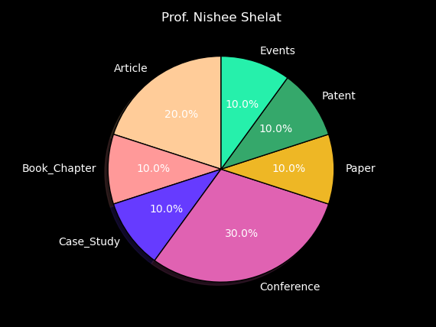
LINKING AND IMPLEMNETATION WITH DEMO
Statistical data

Slide 9
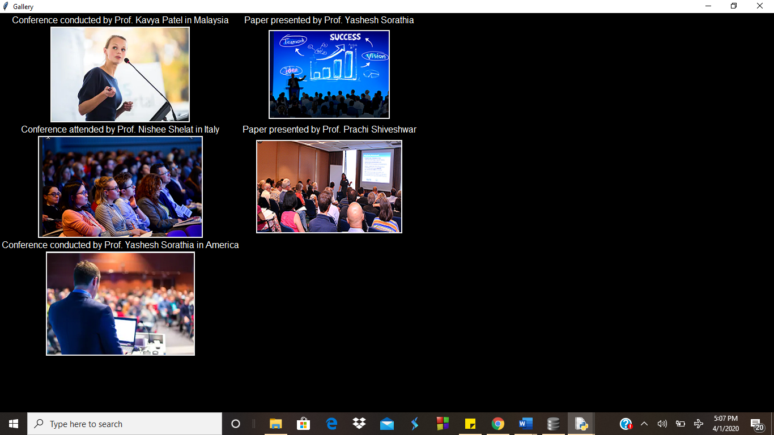
LINKING AND IMPLEMNETATION WITH DEMO
Gallery

Slide 10
CONCLUSION
Thus, we have successfully developed a management system that very well categorises and securely stores, the data of faculty members belonging to a particular university and have linked it to Python for firing queries efficiently. Python plays a vital role to store and display information as and when needed.
We have also successfully implemented all the functionalities of DB Browser and made utmost use of Python GUI Tkinter to the best of our knowledge to develop a database system for the personal progress of the faculty members in a university.
Its further scope could be to make a login page which creates a layer of security for authoritative people to modify the data in the database system. This login would be used only by Administrators and Faculty if required to provide the needed protection of data.

